Slide 1
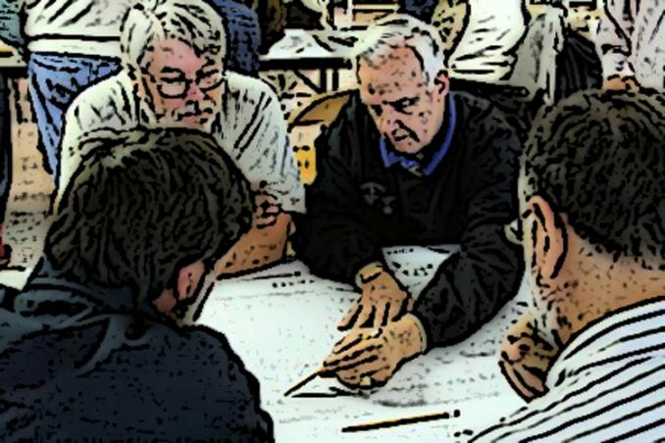
external environment
mandates
opportunities
threats
external
assessment
groan zone
plan
for
planning
strategic issues
strategy
formulation
plan
internal
assessment
adoption
implementation
reassessment/ monitoring
values & mission
strengths
weaknesses
internal environment
Notes:
(5 min.)
Overview of the Strategic Planning Process

Slide 2
external environment
mandates
external
assessment
plan
for
planning
strategic issues
strategy
formulation
plan
internal
assessment
Day 3
Day 2
values & mission
Day 1
internal environment
Notes:
(2 min.)
Structure
After speaking with Chairman Keeney, we agreed to try and update the Plan with (3) 3-hour workshops. If we end up needing a little more time, we may have to schedule an additional workshop just to get things wrapped up.

Slide 3
external environment
mandates
mandates
external
assessment
plan
for
planning
plan
for
planning
strategic issues
strategy
formulation
plan
internal
assessment
values & mission
values & mission
Day 1
internal environment
Notes:
(2 min.)
Schedule
Today we will work on a Plan for Planning and we will work on stakeholders, mandates, values, and mission.

Slide 4
external environment
This is Your Strategic Plan
The purpose of the Strategic Plan is to figure out what is important and what to do about it.
mandates
external
assessment
plan
for
planning
strategic issues
strategy
formulation
plan
internal
assessment
values & mission
internal environment
Notes:
(2 min.)
The purpose of the Strategic Plan is to figure out what is important and what to do about it.

Slide 5
external environment
Stakeholders: List
City of Lancaster
Majestic Farms (rents County Farm)
Foremost
UW-Platteville/Southwest Technical College
UW-Madison – UW-Extension
State of Wisconsin
Townships, Villages, Cities
Grant County Tourism Council
Grant County Economic Development Corporation
Developers (i.e. Dave Bainbridge, James Schneller, AJ Spiegel, Epic Construction, and Jeff Kaiser)
Citizens of Grant County
Sinsinawa Mounds
Vendors –ex. Tricor Insurance, Broadbeck
Unified Board, Grant-Iowa County
Iowa, Lafayette, Jo Davies, Crawford, Richland counties
Southwest Regional Planning Commission
Grant County employees
Major employers
Retail businesses
School districts
Financial institutions
mandates
external
assessment
plan
for
planning
strategic issues
strategy
formulation
plan
internal
assessment
values & mission
internal environment
Notes:
(5 min.)
List of Stakeholders generated from the 2009 Strategic Plan. The purpose of identifying key stakeholders is to have an awareness of what issues are critical and whom do we need to respond to.

Slide 6
external environment
mandates
External Stakeholders
external
assessment
plan
for
planning
Internal Stakeholders
strategic issues
strategy
formulation
plan
internal
assessment
values & mission
internal environment
Notes:
(5 min.)
Let’s take a few minutes to identify the Internal and External Stakeholders for this planning effort. Are there any particular groups that we need to pay special attention to?
(5 min.)
Will this process take into account our Internal and External Stakeholders?
If not, how might we address their needs/concerns?

Slide 7
external environment
mandates
Mandates: What an organization is required to do.
Formal Requirements:
Chapter 59, Wisconsin Statues:
Counties “agents of the State”
Laws pertaining to counties
Describes duties & powers
It’s up to local board to figure out how to use those powers
Informal Expectations:
?
mandates
mandates
external
assessment
plan
for
planning
plan
for
planning
strategic issues
strategy
formulation
plan
plan
internal
assessment
values & mission
internal environment
Notes:
Mandates (15 min.)
Formal Requirements:
From the WCA…
“Counties do not have constitutional home rule authority as cities and villages do. This means that
while cities and villages can basically undertake anything that is not specifically prohibited by state statute or the constitution, counties can only undertake a function that is expressly allowed for, or mandated by, state statute or constitution.”
Court Cases Describing the State-County Relationship…
“This court has often expressed the fundamental rule that counties, as creatures of the legislature, exist
largely for purposes of political organization and administrative convenience . . . Because of its status as an arm of the state, a county cannot be heard to challenge or question the wisdom of its creator . . . It follows logically from this, for example, that a county may not raise a constitutional challenge to a statute.”
What are some Informal Expectations that others have of the County? Record on Flip Chart Sheet. “What traditionally have people expected the County Government to deliver on over the years?”…”What do we need to live up to?”…”What in Grant County has become an important service that is provided to its citizens (quality of life).”

Slide 8
external environment
mandates
Mandates: What an organization is required to do.
Formal Requirements:
Chapter 59, Wisconsin Statues:
Counties “agents of the State”
Laws pertaining to counties
Describes duties & powers
It’s up to local board to figure out how to use those powers
Informal Expectations:
?
mandates
mandates
STOP
external
assessment
plan
for
planning
plan
for
planning
strategic issues
strategy
formulation
plan
plan
internal
assessment
values & mission
internal environment
Notes:
Break (15 min.)

Slide 9
external environment
Values: What an organization believes, reflected in how it acts.
What do we really care about in relating to key stakeholders?
How do we want to be viewed?
What are the values we should have that help indicate how we want to operate?
Exercise: Identify at least (1) value that Grant County Government has.
mandates
mandates
mandates
external
assessment
plan
for
planning
plan
for
planning
strategic issues
strategy
formulation
plan
plan
internal
assessment
values & mission
values & mission
internal environment
Notes:
(50 min.)
Values are the principles an organization believes are important and are reflected in how it acts.
List values that the Grant County Board believes in and should be reflected in how it acts. Consider these (3) questions:
-What do we really care about in relating to key stakeholders?
-How do we want to be viewed?
-What are the values we should have that help indicate how we want to operate?
(more than one-word answer for each)
-(Snow Carding Exercise) record values on Flip Chart Sheet.
-(5 min.) explanation
-(20 min.) generating ideas
-(10 min.) break while Todd arranges into themes
-(15 min.) discussion/summary of values
Themes become headers and Post-Its become descriptions of

Slide 10
external environment
Values: What an organization believes, reflected in how it acts.
What do we really care about in relating to hey stakeholders?
How do we want to be viewed?
What are the values we should have that help indicate how we want to operate?
Exercise: Identify at least (1) value that Grant County Government has.
mandates
mandates
mandates
STOP
external
assessment
plan
for
planning
plan
for
planning
strategic issues
strategy
formulation
plan
plan
internal
assessment
values & mission
values & mission
Notes:
(10 min.) break

Slide 11
external environment
Mission: What an organization does.
Brief and easy to communicate.
Not a vision, value, or strategy.
Exercise: Answer the following questions, then draft a mission statement.
What are the basic social & community needs that we address?
What is our fundamental purpose?
What are we here to do?
mandates
mandates
mandates
external
assessment
plan
for
planning
plan
for
planning
strategic issues
strategy
formulation
plan
plan
internal
assessment
values & mission
values & mission
internal environment
Notes:
(45 min.)
Mission: What an organization does. It is it’s core reason for existing and what it can do uniquely well.
-(Snow Carding Exercise) record statements on Flip Chart Sheet.
-(20 min.) generating ideas
-(10 min.) break while Todd arranges into themes
-(15 min.) discussion/summary of values (underline “true” purpose statements within each-p.11)

Slide 12
external environment
mandates
mandates
mandates
Online Survey
Department Heads
County Board Supervisors
S.W.O.T.
Strengths
Weaknesses
Opportunities
Threats
external
assessment
external
assessment
plan
for
planning
plan
for
planning
strategic issues
strategy
formulation
plan
plan
internal
assessment
internal
assessment
values & mission
internal environment
Notes:
(10 min.)
Homework
(See Watertown), Hopes for the Future (to be used for Vision Sketch)
Go to www.homework.com
Take the S.W.O.T. online survey
End of Day 1

Slide 13
external environment
mandates
mandates
external
assessment
plan
for
planning
plan
for
planning
strategic issues
strategy
formulation
plan
internal
assessment
values & mission
values & mission
Day 1
internal environment
Notes:
(2 min.)
Brief Review
Last time we worked on the Plan for Planning, identified stakeholders, mandates, values, and mission.

Slide 14
external environment
mandates
external
assessment
external
assessment
plan
for
planning
strategic issues
strategy
formulation
strategic issues
plan
internal
assessment
internal
assessment
Day 2
values & mission
internal environment
Notes:
(2 min.)
Schedule
Today will talk about the results of the S.W.O.T. survey, sketch out a vision for the Plan, and identify strategic issues.

Slide 15
external environment
mandates
mandates
mandates
Online Survey Results:
Strengths
Weaknesses
Opportunities
Threats
Vision Sketch:
What does the organization want to look like in the future?
external
assessment
external
assessment
plan
for
planning
plan
for
planning
strategic issues
strategy
formulation
strategic issues
plan
plan
internal
assessment
internal
assessment
values & mission
values & mission
internal environment
Notes:
(20 min.)
S.W.O.T. results
Primary themes
What are the nuggets that we can work with?
(45 min.)
Vision Sketch Refinement
What does Grant County government want to look like in the future? Other than the S.W.O.T. are there any other Hopes for the Future? (Internal and Organizational vs. External and Community-Orientated) In particular, within the government, what you can control…
-(Snow Carding Exercise) record statements on Flip Chart Sheet.
-(20 min.) generating ideas
-(10 min.) break while Todd arranges into themes
-(15 min.) discussion/summary of values

Slide 16
external environment
Strategic Issues: ?
What is the issue?
(needs to have more than one answer)
2. Why is it an issue? Why does it exist? Is it related to:
Values
Mission
Mandates
Strengths
Weaknesses
Opportunities
Threats
3. What are the consequences for not addressing the issue?
4. How will we know when the issue has been successfully addressed?
mandates
mandates
mandates
external
assessment
external
assessment
plan
for
planning
plan
for
planning
strategic issues
strategy
formulation
strategic issues
plan
plan
internal
assessment
internal
assessment
values & mission
values & mission
internal environment
Notes:
(1 hr, 15 min.)
Strategic Issues
1. What is the issue?
(needs to have more than one answer)
2. Why is it an issue? Why does it exist? Is it related to:
Values
Mission
Mandates
Strengths
Weaknesses
Opportunities
Threats
3. What are the consequences for not addressing the issue?
4. How will we know when the issue has been successfully addressed?
(1) Issue per Post-It. Answer (1-4) on each Post-It.
-(Snow Carding Exercise) record statements on Flip Chart Sheet.
-(30 min., 10 for explanation, 20 for ideas) generating ideas
-(15 min.) break while Todd arranges into themes
-(30 min.) discussion and summary of strategic issues

Slide 17
external environment
Strategic Issues: Priorities
Readiness
Capability
Energy/Passion
Sequencing
Other
Homework:
Online Assessment
http//:
mandates
mandates
mandates
external
assessment
external
assessment
plan
for
planning
plan
for
planning
strategic issues
strategy
formulation
strategic issues
plan
plan
internal
assessment
internal
assessment
values & mission
values & mission
internal environment
Notes:
(20 min.)
How do we prioritize our strategic issues? Here are some examples:
Readiness
Capability
Energy/Passion
Sequencing
Other
For our Plan, what factors do you want to consider for prioritizing the strategic issues?
(10 min.)
Homework for next time
Go to the Online assessment and cast your “votes” for the strategic issues. We will examine the results at our next workshop.

Slide 18
external environment
mandates
external
assessment
external
assessment
plan
for
planning
strategic issues
strategy
formulation
strategic issues
plan
internal
assessment
internal
assessment
Day 2
values & mission
internal environment
Notes:
(2 min.)
Brief Review
Last time we met, we generating strategic issues and then voted for those we felt were the most important.

Slide 19
external environment
mandates
external
assessment
plan
for
planning
strategy
formulation
strategic issues
strategy
formulation
plan
plan
internal
assessment
Day 3
values & mission
internal environment
Notes:
(2 min.)
Schedule
Today, we are going to take the results of that poll and begin developing strategies to address those issues. By the end of the workshop, we will have in place an action plan for addressing the most pressing needs facing Grant County.

Slide 20
external environment
Strategy Formulation
Strategic Issue: ?
In what ways can we address this issue?
(1) idea per Post-It
Categorize & Label Responses:
Major Alternative (MA)
Component (C)
Detail (D)
Develop a detailed strategy to successfully implement the Major Alternative (using the Post-Its) .
mandates
mandates
mandates
external
assessment
external
assessment
plan
for
planning
plan
for
planning
strategy
formulation
strategic issues
strategy
formulation
plan
plan
internal
assessment
internal
assessment
values & mission
values & mission
internal environment
Notes:
What is a strategy? (action, initiative, policy)

Slide 21
external environment
Implementation
What is the Priority?
Readiness
Capability
Energy/Passion
Sequencing
Other
mandates
mandates
mandates
Strategy | Success Measure | Timeline | Resources Needed | Responsibility | Synergies
 |  |  |  |  | 1 | 2 | 3 | 4 | 5
1 |  |  |  |  | ●
2 |  |  |  |  |  | ●
3 |  |  |  |  |  |  | ●
4 |  |  |  |  |  |  |  | ●
5 |  |  |  |  |  |  |  |  | ●
external
assessment
external
assessment
plan
for
planning
plan
for
planning
strategic issues
strategy
formulation
strategic issues
strategy
formulation
plan
plan
plan
internal
assessment
internal
assessment
values & mission
values & mission
internal environment
Notes:
Record notes onto flip chart sheet.
What are ready to work on? (Readiness) (Capability) (Energy/Passion)

Slide 22
Purpose
A strategic plan is…
“a disciplined effort to produce fundamental decisions and actions that shape and guide what an organization (or other entity) is, what it does, and why it does it”
What to do.
How to do it.
Notes:
A strategic plan is…
“a disciplined effort to produce fundamental decisions and actions that shape and guide what an organization (or other entity) is, what it does, and why it does it”
In other words, it helps you define:
What to do.
How to do it.

Slide 23
Mission
“To provide the Public with goods and services at a cost-efficient manner.”
“To serve the Public.”
“To collect property taxes and set policy as to how those taxes will be used for the good of the Public.”
Notes:
Committee members developed the following statements to describe the mission of the Grant County Board:
“To provide the Public with goods and services at a cost-efficient manner.”
“To serve the Public.”
“To collect property taxes and set policy as to how those taxes will be used for the good of the Public.”

Slide 24
Values
Integrity
Efficiency
Respect
Honesty
Notes:
Committee members identified the following values of the Grant County Board:
Integrity
Efficiency
Respect
Honesty
These are the guiding principles in which the Grant County Board will act and how it is to be perceived by its stakeholders.

Slide 25
S.W.O.T.
Strengths
Weaknesses
Opportunities
Threats (Challenges)
Notes:
The Administrative Committee reviewed the results of the 2009 Strengths, Weaknesses, Opportunities, & Challenges and believed that there would be little to be gained by repeating that process. Those items from the 2009 Strategic Plan were used to inform this document as follows.

Slide 26
S.W.O.T.
Financial
Staff/Employees
Community Resources
Natural Resources/Tourism

Slide 27
S.W.O.T.
Communications
Economy
Rural Location
Staff/Employees
Facility Planning

Slide 28
S.W.O.T.
Sharing of Resources
Facilities Plan
Economic Potential

Slide 29
S.W.O.T.
Employment/Human Resources
Government Cooperation
Financial

Slide 30
Strategic Issue Survey
A strategic issue is a fundamental policy question or critical challenge affecting Grant County government. In other words, it is a change in how the County operates or something that is impacting the County that needs to be addressed. In order for it to be a strategic issue, it should have more than one way of being resolved and it should be something, that if not addressed, has consequences. Answers to your responses will remain confidential and be incorporated into the 2014 Grant County Strategic Plan..
Notes:
Committee asked for input from Department Heads and County Board Members who are not part of the Administrative Committee.

Slide 31
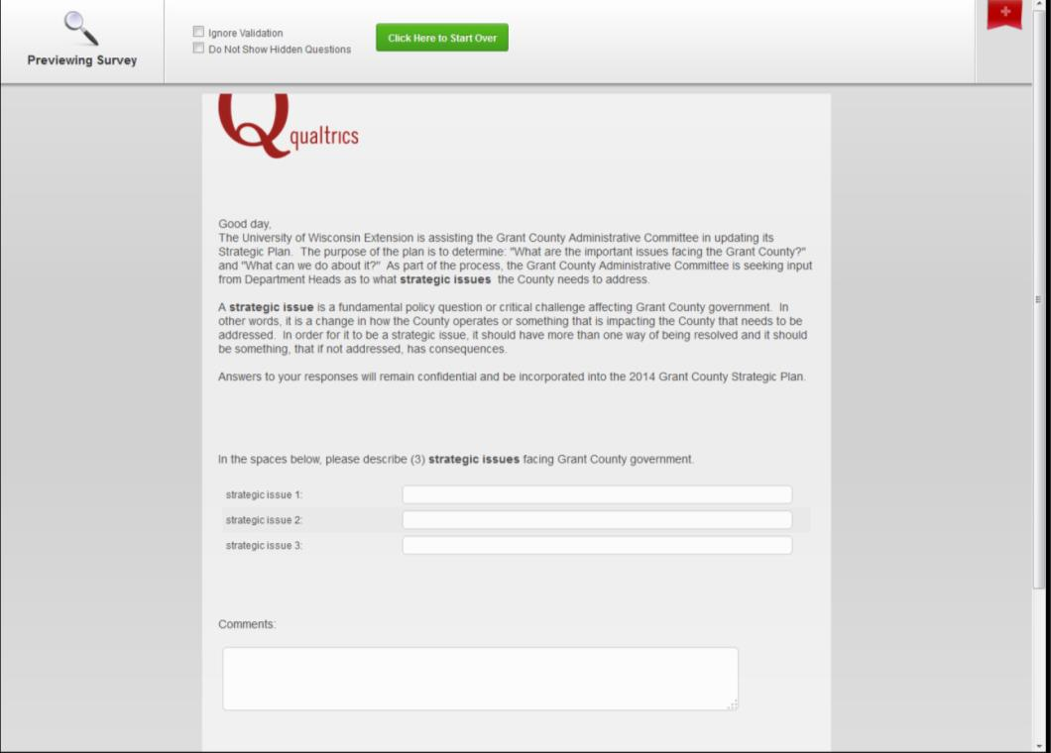
Strategic Issue Survey
Notes:
Committee asked for input from Department Heads and County Board Members who are not part of the Administrative Committee.

Slide 32
Strategic Issue Survey
In the spaces below, please describe (3) strategic issues facing Grant County government.
strategic issue 1:
strategic issue 2:
strategic issue 3:
Notes:
Committee asked for input from Department Heads and County Board Members who are not part of the Administrative Committee.

Slide 33
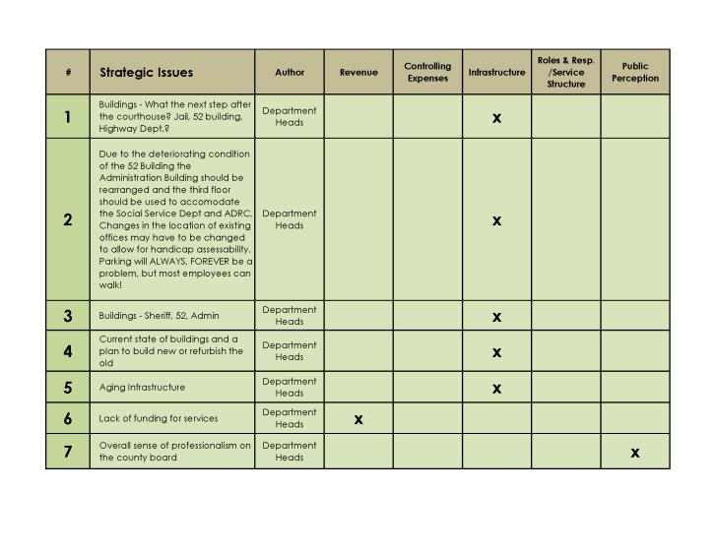
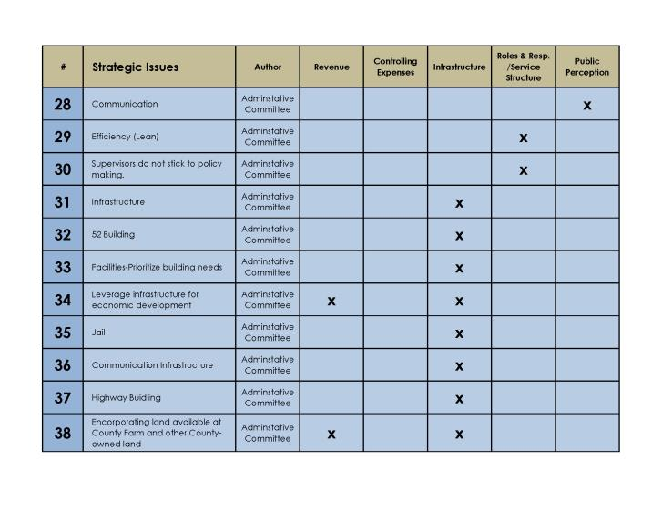
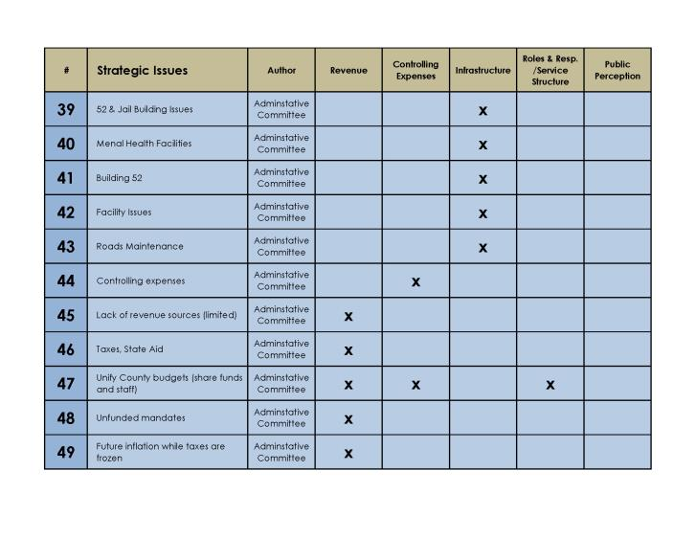
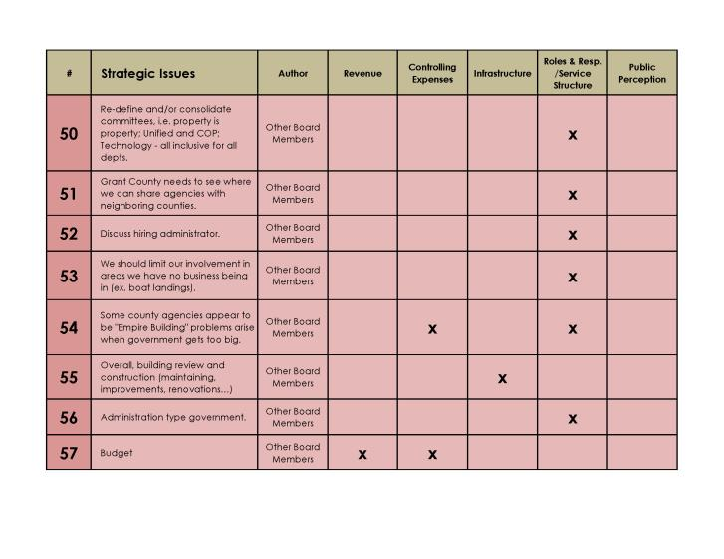
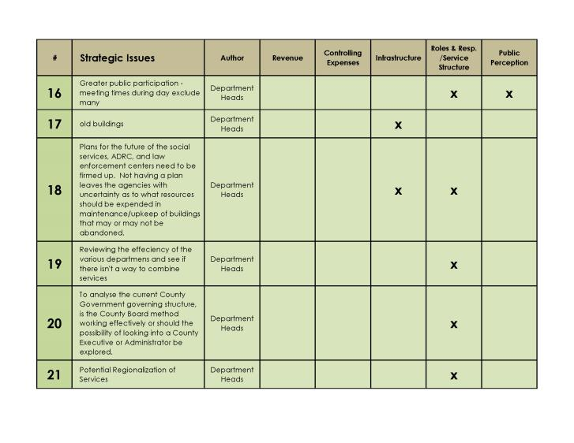
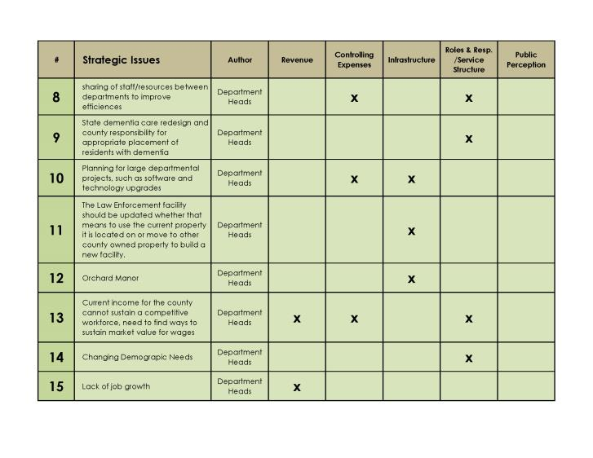
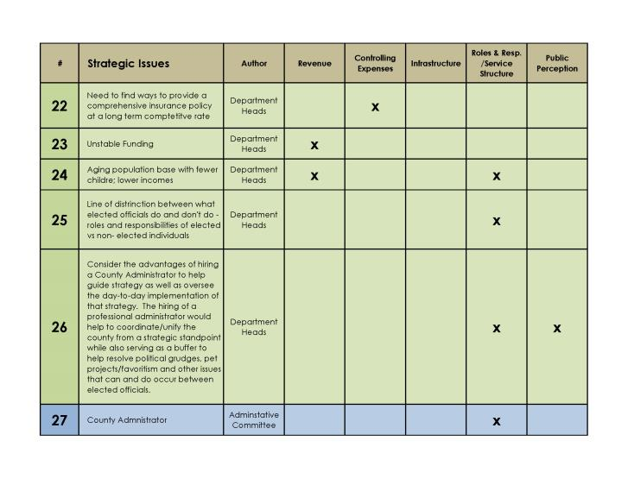
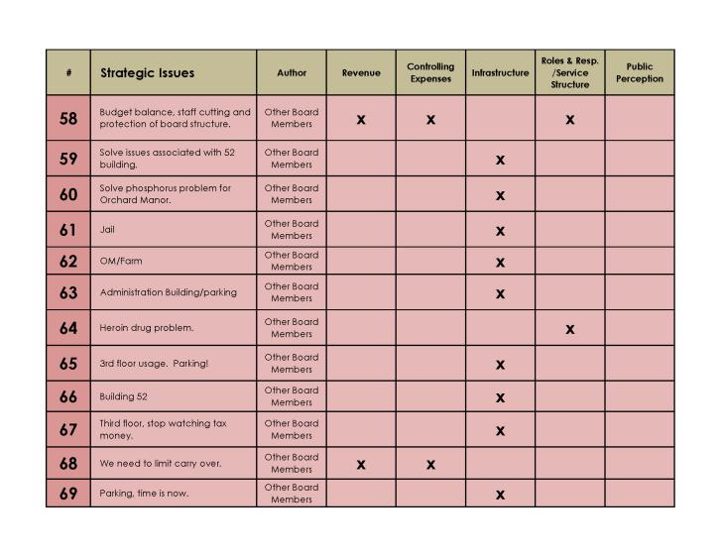
In the spaces below, please describe (3) strategic issues facing Grant County government.
strategic issue 1:
strategic issue 2:
strategic issue 3:
Strategic Issue Survey: Results
Notes:
Committee asked for input from Department Heads and County Board Members who are not part of the Administrative Committee.

Slide 34
Strategic Issue Survey: Themes
Revenue
Controlling Expenses
Infrastructure
Roles & Responsibilities/Service Structure
Public Perception
Notes:
Open-ended responses were sorted into the (5) general themes:
Revenue
Controlling Expenses
Infrastructure
Roles & Responsibilities/ Service Structure*
Public Perception
*After reviewing the responses “Service Structure” was added to “Roles & Responsibilities” to accommodate similar notions.
Some responses contributed to more than one theme.

Slide 35
Notes:
The figure illustrates the number of references towards each theme among Department Heads, Administrative Committee, and the other County Board members.

Slide 36
Strategic Issue Themes
Revenue
Controlling Expenses
Infrastructure
Roles & Responsibilities/Service Structure
Public Perception
Revenue
Controlling Expenses
Budget
Notes:
The Administrative Committee reviewed the results and developed goals for each of the strategic issues as well as strategies to meet them. During this discussion, it was agreed to combine the strategic issues of “Revenue” and “Controlling Expenses” into one theme titled “Budget”.

Slide 37
Strategic Issue Themes
Revenue
Controlling Expenses
Revenue
Controlling Expenses
Infrastructure
Roles & Responsibilities/Service Structure
Public Perception
Budget
Budget
Notes:
The Administrative Committee reviewed the results and developed goals for each of the strategic issues as well as strategies to meet them. During this discussion, it was agreed to combine the strategic issues of “Revenue” and “Controlling Expenses” into one theme titled “Budget”.

Slide 38
Strategic Issue Themes
2014 Grant County Strategic Plan
Budget
Infrastructure
Roles & Responsibilities/Service Structure
Public Perception
Notes:
The Administrative Committee reviewed the results and developed goals for each of the strategic issues as well as strategies to meet them. During this discussion, it was agreed to combine the strategic issues of “Revenue” and “Controlling Expenses” into one theme titled “Budget”.

Slide 39
Budget (Revenue + Controlling Expenses)
Goal 1: Maximize All Revenue Sources
It was shared among the board members that the County should make all attempts to maximize all sources of revenue coming in.
Strategy 1A: Hire a Professional Administrator
Description: To oversee the financial operations of departments and identify opportunities that would increase revenue.
Barriers: Finding enough money to pay an administrator and acquiring enough votes on the Grant County Board to make the change.
First Steps: Developing a job description, finding monies within the budget to pay for the position, and looking at other examples of professional administrators.
Notes:
Review the following for each strategic issue:
Are we clear about what the issue is?
What specific goals do we want to achieve?
How might we reach these goals?
What might prevent this alternative from succeeding?
What are the big steps needed?
What will we need to complete these steps?

Slide 40
Budget (Revenue + Controlling Expenses)
Goal 2: Create a Business-Friendly Atmosphere
Committee members identified a common need to retain and attract businesses in Grant County.
Strategy 2A: Grant County “Buys Local”
Description: To lead by example by giving preference to local vendors.
Barriers: The perceived and actual availability of goods and services.
First Steps: To develop a “buy local preference” policy for Grant County government that requires initial contact for pricing to be “local”.
Notes:
Review the following for each strategic issue:
Are we clear about what the issue is?
What specific goals do we want to achieve?
How might we reach these goals?
What might prevent this alternative from succeeding?
What are the big steps needed?
What will we need to complete these steps?

Slide 41
Budget (Revenue + Controlling Expenses)
Goal 2: Create a Business-Friendly Atmosphere
Committee members identified a common need to retain and attract businesses in Grant County.
Strategy 2B: Work With Agencies and Organizations to Attract, Retain, and Expand Businesses
Description: Grow revenue by increasing number of jobs and population in Grant County.
Barriers: Government tends to have “strings attached” when working with businesses.
First Steps: Continue to support the efforts of Grant County Economic Development Corporation, UW Extension, Southwest Community Action Program, and Workforce Development Board to attract, retain, and expand businesses.
Notes:
Review the following for each strategic issue:
Are we clear about what the issue is?
What specific goals do we want to achieve?
How might we reach these goals?
What might prevent this alternative from succeeding?
What are the big steps needed?
What will we need to complete these steps?

Slide 42
Budget (Revenue + Controlling Expenses)
Goal 3: Control Expenses
Committee members identified a common need to control expenses and look for efficiencies in materials, labor, and space.
Strategy 3A: Lean Government Approach to Management
Description: Make a concerted effort to identify areas of collaboration and consolidation to improve efficiencies.
Barriers: Reluctance to share.
First Steps: Provide Lean Government training to department heads.
Notes:
Review the following for each strategic issue:
Are we clear about what the issue is?
What specific goals do we want to achieve?
How might we reach these goals?
What might prevent this alternative from succeeding?
What are the big steps needed?
What will we need to complete these steps?

Slide 43
Infrastructure
Goal 4: Building Plan for the Future
Committee members identified a common need to develop a comprehensive building master plan that would take into account all existing facilities and services and any future facilities and services.
Strategy 4A: Develop a Master Plan
Description: Consider existing building studies and look at the “big picture” to allow for the most efficient and appropriate use of space, funds, and services.
Barriers: Costs of hiring a consultant; perceived issues with parking; security concerns; resistance to change from staff; political tension among County Board members.
First Steps: Hire a consultant who has experience with both government facility master planning and public services in Wisconsin to facilitate a process that will result in an action plan.
Notes:
Review the following for each strategic issue:
Are we clear about what the issue is?
What specific goals do we want to achieve?
How might we reach these goals?
What might prevent this alternative from succeeding?
What are the big steps needed?
What will we need to complete these steps?

Slide 44
Infrastructure
Goal 5: Maintain County Transportation System
Committee members identified a common need to maintain “access” and “standards” of County roads and bridges.
Strategy 5A: Maintain Funding & Controlling Costs
Description: Provide adequate funding for transportation projects to assure high-quality standards.
Barriers: Increased costs of labor and materials.
First Steps: Lean Government training for Highway Department.
Notes:
Review the following for each strategic issue:
Are we clear about what the issue is?
What specific goals do we want to achieve?
How might we reach these goals?
What might prevent this alternative from succeeding?
What are the big steps needed?
What will we need to complete these steps?

Slide 45
Infrastructure
Goal 5: Maintain County Transportation System
Committee members identified a common need to maintain “access” and “standards” of County roads and bridges.
Strategy 5B: Mitigate Negative Impacts of Implements of Husbandry
Description: Coordinate the adoption and enforcement of Implements of Husbandry (IOH) Ordinances in Grant County among all jurisdictions.
Barriers: Political, technical, and legal complexities.
First Steps: Work with local units of government to adopt the Grant County IOH Ordinance.
Notes:
Review the following for each strategic issue:
Are we clear about what the issue is?
What specific goals do we want to achieve?
How might we reach these goals?
What might prevent this alternative from succeeding?
What are the big steps needed?
What will we need to complete these steps?

Slide 46
Roles & Responsibilities/Service Structure
Goal 6: Identify Possible Efficiencies with Service Structure
Committee members identified a common need to consider the restructuring and possible consolidation of departments prior to or as part of the development of a building master plan.
Strategy 6A: Evaluate Existing Service Structure
Description: Work with a skilled facilitator to examine department structure for the purpose of identifying potential improvements.
Barriers: Possible costs in hiring a consultant. Resistance to change from staff.
First Steps: Locate a skilled facilitator in either UW Extension or in the private sector with extensive knowledge of county services.
Notes:
Review the following for each strategic issue:
Are we clear about what the issue is?
What specific goals do we want to achieve?
How might we reach these goals?
What might prevent this alternative from succeeding?
What are the big steps needed?
What will we need to complete these steps?
)

Slide 47
Roles & Responsibilities/Service Structure
Goal 7: Provide Better Meal Program for Elderly
Committee members identified a common need to provide a nutritious and convenient meal program to the elderly that lacks a negative “stigma”.
Strategy 7A: Investigate Alternative Meal Programs
Description: Support current efforts to investigate the feasibility of a “restaurant voucher” system instead of the current meal site program.
Barriers: Unknown costs or legal considerations. Resistance to change from staff.
First Steps: Ongoing
Notes:
Review the following for each strategic issue:
Are we clear about what the issue is?
What specific goals do we want to achieve?
How might we reach these goals?
What might prevent this alternative from succeeding?
What are the big steps needed?
What will we need to complete these steps?
)

Slide 48
Public Perception
Goal 8: Allow the Public to Be a Part of the Process
Committee members identified a common need to provide opportunities for the Public to be more involved in Grant County government.
Strategy 8A: Promote Good Governance Through Youth
Description: Work with local students to create and manage social media to educate the Public about Grant County government.
Barriers: School districts may not have an interest. Content may be sensitive.
First Steps: Contact Tom Martin at CESA 3 to identify school districts that may have an interest in working with Grant County government.
Notes:
Review the following for each strategic issue:
Are we clear about what the issue is?
What specific goals do we want to achieve?
How might we reach these goals?
What might prevent this alternative from succeeding?
What are the big steps needed?
What will we need to complete these steps?

Slide 49
Selection
What are we ready to do?
What are we capable of doing?
What do we have energy to do?
What are the “Secondary Impacts” for each strategy?
Sequencing of actions.
Notes:
Selection
What are we ready to do?
What are we capable of doing?
What do we have energy to do?
What “Secondary Impacts” do each strategy have?

Slide 50
n= Yes, x= Maybe, o= No
Selection
Strategy | Ready | Capable | Energy | Secondary Impacts |  |  |  |  |  |  |  |  |  | Ranking
 |  |  |  | 1A | 2A | 2B | 3A | 4A | 5A | 5B | 6A | 7A | 8A
1A: Hire a Professional Administrator
2A: Grant County “Buys Local”
2B: Work With Agencies and Organizations to Attract…
3A: Lean Government Approach to Management
4A: Develop a Master Plan
5A: Maintain Funding
5B: Mitigate Negative Impacts of Implements…
6A: Evaluate Existing Service Structure
7A: Investigate Alternative Meal Programs
8A: Promote Good Governance Through Youth
Notes:
Selection
What are we ready to do?
What are we capable of doing?
What do we have energy to do?

Slide 51
n= Yes, x= Maybe, o= No
Selection
Strategy | Ready | Capable | Energy | Secondary Impacts |  |  |  |  |  |  |  |  |  | Ranking
 |  |  |  | 1A | 2A | 2B | 3A | 4A | 5A | 5B | 6A | 7A | 8A
1A: Hire a Professional Administrator |  |  |  | n | o | x | n | x | x | x | x | x | x
2A: Grant County “Buys Local”
2B: Work With Agencies and Organizations to Attract…
3A: Lean Government Approach to Management
4A: Develop a Master Plan
5A: Maintain Funding
5B: Mitigate Negative Impacts of Implements…
6A: Evaluate Existing Service Structure
7A: Investigate Alternative Meal Programs
8A: Promote Good Governance Through Youth
Notes:
Selection
What are we ready to do?
What are we capable of doing?
What do we have energy to do?

Slide 52
n= Yes, x= Maybe, o= No
Selection
Strategy | Ready | Capable | Energy | Secondary Impacts |  |  |  |  |  |  |  |  |  | Ranking
 |  |  |  | 1A | 2A | 2B | 3A | 4A | 5A | 5B | 6A | 7A | 8A
1A: Hire a Professional Administrator |  |  |  | n | o | x | n | x | x | x | x | x | x
2A: Grant County “Buys Local” |  |  |  | o | n | n | o | o | o | o | o | n | n
2B: Work With Agencies and Organizations to Attract… |  |  |  | o | n | n | x | o | n | o | n | n | n
3A: Lean Government Approach to Management |  |  |  | x | x | x | n | n | n | x | n | x | n
4A: Develop a Master Plan |  |  |  | o | o | o | n | n | n | o | n | x | x
5A: Maintain Funding |  |  |  | o | o | x | n | n | n | n | x | x | x
5B: Mitigate Negative Impacts of Implements… |  |  |  | o | o | o | x | x | o | n | o | o | x
6A: Evaluate Existing Service Structure |  |  |  | x | o | o | n | n | x | o | n | n | x
7A: Investigate Alternative Meal Programs |  |  |  | o | n | o | n | o | o | o | n | n | x
8A: Promote Good Governance Through Youth |  |  |  | n | n | n | n | n | n | n | n | n | n
Notes:
Selection
What are we ready to do?
What are we capable of doing?
What do we have energy to do?

Slide 53
n= Yes, x= Maybe, o= No
Selection
Strategy | Ready | Capable | Energy | Secondary Impacts |  |  |  |  |  |  |  |  |  | Ranking
 |  |  |  | 1A | 2A | 2B | 3A | 4A | 5A | 5B | 6A | 7A | 8A
1A: Hire a Professional Administrator | o |  |  | n | o | x | n | x | x | x | x | x | x
2A: Grant County “Buys Local” | n |  |  | o | n | n | o | o | o | o | o | n | n
2B: Work With Agencies and Organizations to Attract… | n |  |  | o | n | n | x | o | n | o | n | n | n
3A: Lean Government Approach to Management | n |  |  | x | x | x | n | n | n | x | n | x | n
4A: Develop a Master Plan | n |  |  | o | o | o | n | n | n | o | n | x | x
5A: Maintain Funding | n |  |  | o | o | x | n | n | n | n | x | x | x
5B: Mitigate Negative Impacts of Implements… | n |  |  | o | o | o | x | x | o | n | o | o | x
6A: Evaluate Existing Service Structure | n |  |  | x | o | o | n | n | x | o | n | n | x
7A: Investigate Alternative Meal Programs | n |  |  | o | n | o | n | o | o | o | n | n | x
8A: Promote Good Governance Through Youth | n |  |  | n | n | n | n | n | n | n | n | n | n
Notes:
Selection
What are we ready to do?
What are we capable of doing?
What do we have energy to do?

Slide 54
n= Yes, x= Maybe, o= No
Selection
Strategy | Ready | Capable | Energy | Secondary Impacts |  |  |  |  |  |  |  |  |  | Ranking
 |  |  |  | 1A | 2A | 2B | 3A | 4A | 5A | 5B | 6A | 7A | 8A
1A: Hire a Professional Administrator | o | n |  | n | o | x | n | x | x | x | x | x | x
2A: Grant County “Buys Local” | n | n |  | o | n | n | o | o | o | o | o | n | n
2B: Work With Agencies and Organizations to Attract… | n | n |  | o | n | n | x | o | n | o | n | n | n
3A: Lean Government Approach to Management | n | n |  | x | x | x | n | n | n | x | n | x | n
4A: Develop a Master Plan | n | n |  | o | o | o | n | n | n | o | n | x | x
5A: Maintain Funding | n | n |  | o | o | x | n | n | n | n | x | x | x
5B: Mitigate Negative Impacts of Implements… | n | n |  | o | o | o | x | x | o | n | o | o | x
6A: Evaluate Existing Service Structure | n | n |  | x | o | o | n | n | x | o | n | n | x
7A: Investigate Alternative Meal Programs | n | n |  | o | n | o | n | o | o | o | n | n | x
8A: Promote Good Governance Through Youth | n | n |  | n | n | n | n | n | n | n | n | n | n
Notes:
Selection
What are we ready to do?
What are we capable of doing?
What do we have energy to do?

Slide 55
n= Yes, x= Maybe, o= No
Selection
Strategy | Ready | Capable | Energy | Secondary Impacts |  |  |  |  |  |  |  |  |  | Ranking
 |  |  |  | 1A | 2A | 2B | 3A | 4A | 5A | 5B | 6A | 7A | 8A
1A: Hire a Professional Administrator | o | n | o | n | o | x | n | x | x | x | x | x | x
2A: Grant County “Buys Local” | n | n | n | o | n | n | o | o | o | o | o | n | n
2B: Work With Agencies and Organizations to Attract… | n | n | n | o | n | n | x | o | n | o | n | n | n
3A: Lean Government Approach to Management | n | n | n | x | x | x | n | n | n | x | n | x | n
4A: Develop a Master Plan | n | n | n | o | o | o | n | n | n | o | n | x | x
5A: Maintain Funding | n | n | n | o | o | x | n | n | n | n | x | x | x
5B: Mitigate Negative Impacts of Implements… | n | n | n | o | o | o | x | x | o | n | o | o | x
6A: Evaluate Existing Service Structure | n | n | n | x | o | o | n | n | x | o | n | n | x
7A: Investigate Alternative Meal Programs | n | n | n | o | n | o | n | o | o | o | n | n | x
8A: Promote Good Governance Through Youth | n | n | n | n | n | n | n | n | n | n | n | n | n
Notes:
Selection
What are we ready to do?
What are we capable of doing?
What do we have energy to do?

Slide 56
n= Yes, x= Maybe, o= No
Selection
Strategy | Ready | Capable | Energy | Secondary Impacts |  |  |  |  |  |  |  |  |  | Ranking
 |  |  |  | 1A | 2A | 2B | 3A | 4A | 5A | 5B | 6A | 7A | 8A
1A: Hire a Professional Administrator | o | n | o | n | o | x | n | x | x | x | x | x | x
2A: Grant County “Buys Local” | n | n | n | o | n | n | o | o | o | o | o | n | n
2B: Work With Agencies and Organizations to Attract… | n | n | n | o | n | n | x | o | n | o | n | n | n | -
3A: Lean Government Approach to Management | n | n | n | x | x | x | n | n | n | x | n | x | n | -
4A: Develop a Master Plan | n | n | n | o | o | o | n | n | n | o | n | x | x
5A: Maintain Funding | n | n | n | o | o | x | n | n | n | n | x | x | x | -
5B: Mitigate Negative Impacts of Implements… | n | n | n | o | o | o | x | x | o | n | o | o | x
6A: Evaluate Existing Service Structure | n | n | n | x | o | o | n | n | x | o | n | n | x
7A: Investigate Alternative Meal Programs | n | n | n | o | n | o | n | o | o | o | n | n | x | -
8A: Promote Good Governance Through Youth | n | n | n | n | n | n | n | n | n | n | n | n | n
Notes:
Selection
What are we ready to do?
What are we capable of doing?
What do we have energy to do?

Slide 57
n= Yes, x= Maybe, o= No
Selection
Strategy | Ready | Capable | Energy | Secondary Impacts |  |  |  |  |  |  |  |  |  | Ranking
 |  |  |  | 1A | 2A | 2B | 3A | 4A | 5A | 5B | 6A | 7A | 8A
1A: Hire a Professional Administrator | o | n | o | n | o | x | n | x | x | x | x | x | x | 2
2A: Grant County “Buys Local” | n | n | n | o | n | n | o | o | o | o | o | n | n | 1
2B: Work With Agencies and Organizations to Attract… | n | n | n | o | n | n | x | o | n | o | n | n | n | -
3A: Lean Government Approach to Management | n | n | n | x | x | x | n | n | n | x | n | x | n | -
4A: Develop a Master Plan | n | n | n | o | o | o | n | n | n | o | n | x | x | 4
5A: Maintain Funding | n | n | n | o | o | x | n | n | n | n | x | x | x | -
5B: Mitigate Negative Impacts of Implements… | n | n | n | o | o | o | x | x | o | n | o | o | x | 1
6A: Evaluate Existing Service Structure | n | n | n | x | o | o | n | n | x | o | n | n | x | 3
7A: Investigate Alternative Meal Programs | n | n | n | o | n | o | n | o | o | o | n | n | x | -
8A: Promote Good Governance Through Youth | n | n | n | n | n | n | n | n | n | n | n | n | n | 1
Notes:
Selection
What are we ready to do?
What are we capable of doing?
What do we have energy to do?

Slide 58
Strategy | Timeline | First Steps
1A: Hire a Professional Administrator | 3 - 6 months | Contact UWEX Local Government Center for “best practices”.
2A: Grant County “Buys Local” | 3 months | Contact Corporation Counsel to develop policy language.
2B: Work With Agencies and Organizations to Attract… | ongoing | Continue to work with existing partners.
3A: Lean Government Approach to Management | ongoing | Continue to support training efforts.
4A: Develop a Master Plan | 1 year | Find a reputable firm with Wisconsin county services background and facility master planning experience.
5A: Maintain Funding | ongoing | Provide Lean government training.
5B: Mitigate Negative Impacts of Implements… | 3-6 months | Work with Highway Commissioner, Sheriff, and Corporation Counsel to develop a letter to local government. Be sure to include input from Wisconsin Towns Association and the Wisconsin League of Municipalities.
6A: Evaluate Existing Service Structure | 6 months – 1 year | Contact UWEX Local Government Center for “best practices”. May need to hire a private consultant.
7A: Investigate Alternative Meal Programs | ongoing | Contact Corporation Counsel to develop policy language.
8A: Promote Good Governance Through Youth | 3 months | Contact CESA 3 to assist in finding school districts interested in working with Grant County government.
n= Yes, x= Maybe, o= No
Action Plan
Notes:
Sequencing of the Action Plan
The Administrative Committee recognized that strategies 2B, 3A, 5A, and 7A are largely activities that are “ongoing” and need little “new” action to be taken. Strategies 2A, 5B, and 8A are strategies in which implementation could occur immediately with little effort from the Administrative Committee and should begin as soon as possible. Although strategy 4A is perhaps the “most important” strategy among Committee members, it was agreed that both 1A and 6A should be addressed prior.

Slide 59
Strategy | Timeline | First Steps
1A: Hire a Professional Administrator | 3 - 6 months | Contact UWEX Local Government Center for “best practices”.
2A: Grant County “Buys Local” | 3 months | Contact Corporation Counsel to develop policy language.
2B: Work With Agencies and Organizations to Attract… | ongoing | Continue to work with existing partners.
3A: Lean Government Approach to Management | ongoing | Continue to support training efforts.
4A: Develop a Master Plan | 1 year | Find a reputable firm with Wisconsin county services background and facility master planning experience.
5A: Maintain Funding | ongoing | Provide Lean government training.
5B: Mitigate Negative Impacts of Implements… | 3-6 months | Work with Highway Commissioner, Sheriff, and Corporation Counsel to develop a letter to local government. Be sure to include input from Wisconsin Towns Association and the Wisconsin League of Municipalities.
6A: Evaluate Existing Service Structure | 6 months – 1 year | Contact UWEX Local Government Center for “best practices”. May need to hire a private consultant.
7A: Investigate Alternative Meal Programs | ongoing | Contact Corporation Counsel to develop policy language.
8A: Promote Good Governance Through Youth | 3 months | Contact CESA 3 to assist in finding school districts interested in working with Grant County government.
n= Yes, x= Maybe, o= No
Action Plan
Ongoing Strategies
Notes:
Sequencing of the Action Plan
The Administrative Committee recognized that strategies 2B, 3A, 5A, and 7A are largely activities that are “ongoing” and need little “new” action to be taken. Strategies 2A, 5B, and 8A are strategies in which implementation could occur immediately with little effort from the Administrative Committee and should begin as soon as possible. Although strategy 4A is perhaps the “most important” strategy among Committee members, it was agreed that both 1A and 6A should be addressed prior.

Slide 60
Strategy | Timeline | First Steps
1A: Hire a Professional Administrator | 3 - 6 months | Contact UWEX Local Government Center for “best practices”.
2A: Grant County “Buys Local” | 3 months | Contact Corporation Counsel to develop policy language.
2B: Work With Agencies and Organizations to Attract… | ongoing | Continue to work with existing partners.
3A: Lean Government Approach to Management | ongoing | Continue to support training efforts.
4A: Develop a Master Plan | 1 year | Find a reputable firm with Wisconsin county services background and facility master planning experience.
5A: Maintain Funding | ongoing | Provide Lean government training.
5B: Mitigate Negative Impacts of Implements… | 3-6 months | Work with Highway Commissioner, Sheriff, and Corporation Counsel to develop a letter to local government. Be sure to include input from Wisconsin Towns Association and the Wisconsin League of Municipalities.
6A: Evaluate Existing Service Structure | 6 months – 1 year | Contact UWEX Local Government Center for “best practices”. May need to hire a private consultant.
7A: Investigate Alternative Meal Programs | ongoing | Contact Corporation Counsel to develop policy language.
8A: Promote Good Governance Through Youth | 3 months | Contact CESA 3 to assist in finding school districts interested in working with Grant County government.
n= Yes, x= Maybe, o= No
Action Plan
Notes:
Sequencing of the Action Plan
The Administrative Committee recognized that strategies 2B, 3A, 5A, and 7A are largely activities that are “ongoing” and need little “new” action to be taken. Strategies 2A, 5B, and 8A are strategies in which implementation could occur immediately with little effort from the Administrative Committee and should begin as soon as possible. Although strategy 4A is perhaps the “most important” strategy among Committee members, it was agreed that both 1A and 6A should be addressed prior.

Slide 61
Strategy | Timeline | First Steps
1A: Hire a Professional Administrator | 3 - 6 months | Contact UWEX Local Government Center for “best practices”.
2A: Grant County “Buys Local” | 3 months | Contact Corporation Counsel to develop policy language.
2B: Work With Agencies and Organizations to Attract… | ongoing | Continue to work with existing partners.
3A: Lean Government Approach to Management | ongoing | Continue to support training efforts.
4A: Develop a Master Plan | 1 year | Find a reputable firm with Wisconsin county services background and facility master planning experience.
5A: Maintain Funding | ongoing | Provide Lean government training.
5B: Mitigate Negative Impacts of Implements… | 3-6 months | Work with Highway Commissioner, Sheriff, and Corporation Counsel to develop a letter to local government. Be sure to include input from Wisconsin Towns Association and the Wisconsin League of Municipalities.
6A: Evaluate Existing Service Structure | 6 months – 1 year | Contact UWEX Local Government Center for “best practices”. May need to hire a private consultant.
7A: Investigate Alternative Meal Programs | ongoing | Contact Corporation Counsel to develop policy language.
8A: Promote Good Governance Through Youth | 3 months | Contact CESA 3 to assist in finding school districts interested in working with Grant County government.
n= Yes, x= Maybe, o= No
Action Plan
Notes:
Sequencing of the Action Plan
The Administrative Committee recognized that strategies 2B, 3A, 5A, and 7A are largely activities that are “ongoing” and need little “new” action to be taken. Strategies 2A, 5B, and 8A are strategies in which implementation could occur immediately with little effort from the Administrative Committee and should begin as soon as possible. Although strategy 4A is perhaps the “most important” strategy among Committee members, it was agreed that both 1A and 6A should be addressed prior.

Slide 62
Strategy | Timeline | First Steps
1A: Hire a Professional Administrator | 3 - 6 months | Contact UWEX Local Government Center for “best practices”.
2A: Grant County “Buys Local” | 3 months | Contact Corporation Counsel to develop policy language.
2B: Work With Agencies and Organizations to Attract… | ongoing | Continue to work with existing partners.
3A: Lean Government Approach to Management | ongoing | Continue to support training efforts.
4A: Develop a Master Plan | 1 year | Find a reputable firm with Wisconsin county services background and facility master planning experience.
5A: Maintain Funding | ongoing | Provide Lean government training.
5B: Mitigate Negative Impacts of Implements… | 3-6 months | Work with Highway Commissioner, Sheriff, and Corporation Counsel to develop a letter to local government. Be sure to include input from Wisconsin Towns Association and the Wisconsin League of Municipalities.
6A: Evaluate Existing Service Structure | 6 months – 1 year | Contact UWEX Local Government Center for “best practices”. May need to hire a private consultant.
7A: Investigate Alternative Meal Programs | ongoing | Contact Corporation Counsel to develop policy language.
8A: Promote Good Governance Through Youth | 3 months | Contact CESA 3 to assist in finding school districts interested in working with Grant County government.
n= Yes, x= Maybe, o= No
Action Plan
Notes:
Sequencing of the Action Plan
The Administrative Committee recognized that strategies 2B, 3A, 5A, and 7A are largely activities that are “ongoing” and need little “new” action to be taken. Strategies 2A, 5B, and 8A are strategies in which implementation could occur immediately with little effort from the Administrative Committee and should begin as soon as possible. Although strategy 4A is perhaps the “most important” strategy among Committee members, it was agreed that both 1A and 6A should be addressed prior.

Slide 63
Strategy | Timeline | First Steps
1A: Hire a Professional Administrator | 3 - 6 months | Contact UWEX Local Government Center for “best practices”.
2A: Grant County “Buys Local” | 3 months | Contact Corporation Counsel to develop policy language.
2B: Work With Agencies and Organizations to Attract… | ongoing | Continue to work with existing partners.
3A: Lean Government Approach to Management | ongoing | Continue to support training efforts.
4A: Develop a Master Plan | 1 year | Find a reputable firm with Wisconsin county services background and facility master planning experience.
5A: Maintain Funding | ongoing | Provide Lean government training.
5B: Mitigate Negative Impacts of Implements… | 3-6 months | Work with Highway Commissioner, Sheriff, and Corporation Counsel to develop a letter to local government. Be sure to include input from Wisconsin Towns Association and the Wisconsin League of Municipalities.
6A: Evaluate Existing Service Structure | 6 months – 1 year | Contact UWEX Local Government Center for “best practices”. May need to hire a private consultant.
7A: Investigate Alternative Meal Programs | ongoing | Contact Corporation Counsel to develop policy language.
8A: Promote Good Governance Through Youth | 3 months | Contact CESA 3 to assist in finding school districts interested in working with Grant County government.
n= Yes, x= Maybe, o= No
Action Plan
Notes:
Sequencing of the Action Plan
The Administrative Committee recognized that strategies 2B, 3A, 5A, and 7A are largely activities that are “ongoing” and need little “new” action to be taken. Strategies 2A, 5B, and 8A are strategies in which implementation could occur immediately with little effort from the Administrative Committee and should begin as soon as possible. Although strategy 4A is perhaps the “most important” strategy among Committee members, it was agreed that both 1A and 6A should be addressed prior.

Slide 64
Strategy | Timeline | First Steps
1A: Hire a Professional Administrator | 3 - 6 months | Contact UWEX Local Government Center for “best practices”.
2A: Grant County “Buys Local” | 3 months | Contact Corporation Counsel to develop policy language.
2B: Work With Agencies and Organizations to Attract… | ongoing | Continue to work with existing partners.
3A: Lean Government Approach to Management | ongoing | Continue to support training efforts.
4A: Develop a Master Plan | 1 year | Find a reputable firm with Wisconsin county services background and facility master planning experience.
5A: Maintain Funding | ongoing | Provide Lean government training.
5B: Mitigate Negative Impacts of Implements… | 3-6 months | Work with Highway Commissioner, Sheriff, and Corporation Counsel to develop a letter to local government. Be sure to include input from Wisconsin Towns Association and the Wisconsin League of Municipalities.
6A: Evaluate Existing Service Structure | 6 months – 1 year | Contact UWEX Local Government Center for “best practices”. May need to hire a private consultant.
7A: Investigate Alternative Meal Programs | ongoing | Contact Corporation Counsel to develop policy language.
8A: Promote Good Governance Through Youth | 3 months | Contact CESA 3 to assist in finding school districts interested in working with Grant County government.
n= Yes, x= Maybe, o= No
Action Plan
Notes:
Sequencing of the Action Plan
The Administrative Committee recognized that strategies 2B, 3A, 5A, and 7A are largely activities that are “ongoing” and need little “new” action to be taken. Strategies 2A, 5B, and 8A are strategies in which implementation could occur immediately with little effort from the Administrative Committee and should begin as soon as possible. Although strategy 4A is perhaps the “most important” strategy among Committee members, it was agreed that both 1A and 6A should be addressed prior.

Slide 65
Strategy | Timeline | First Steps
1A: Hire a Professional Administrator | 3 - 6 months | Contact UWEX Local Government Center for “best practices”.
2A: Grant County “Buys Local” | 3 months | Contact Corporation Counsel to develop policy language.
2B: Work With Agencies and Organizations to Attract… | ongoing | Continue to work with existing partners.
3A: Lean Government Approach to Management | ongoing | Continue to support training efforts.
4A: Develop a Master Plan | 1 year | Find a reputable firm with Wisconsin county services background and facility master planning experience.
5A: Maintain Funding | ongoing | Provide Lean government training.
5B: Mitigate Negative Impacts of Implements… | 3-6 months | Work with Highway Commissioner, Sheriff, and Corporation Counsel to develop a letter to local government. Be sure to include input from Wisconsin Towns Association and the Wisconsin League of Municipalities.
6A: Evaluate Existing Service Structure | 6 months – 1 year | Contact UWEX Local Government Center for “best practices”. May need to hire a private consultant.
7A: Investigate Alternative Meal Programs | ongoing | Contact Corporation Counsel to develop policy language.
8A: Promote Good Governance Through Youth | 3 months | Contact CESA 3 to assist in finding school districts interested in working with Grant County government.
n= Yes, x= Maybe, o= No
Action Plan
Notes:
Sequencing of the Action Plan
The Administrative Committee recognized that strategies 2B, 3A, 5A, and 7A are largely activities that are “ongoing” and need little “new” action to be taken. Strategies 2A, 5B, and 8A are strategies in which implementation could occur immediately with little effort from the Administrative Committee and should begin as soon as possible. Although strategy 4A is perhaps the “most important” strategy among Committee members, it was agreed that both 1A and 6A should be addressed prior.

Slide 66
Strategy | Timeline | First Steps
1A: Hire a Professional Administrator | 3 - 6 months | Contact UWEX Local Government Center for “best practices”.
2A: Grant County “Buys Local” | 3 months | Contact Corporation Counsel to develop policy language.
2B: Work With Agencies and Organizations to Attract… | ongoing | Continue to work with existing partners.
3A: Lean Government Approach to Management | ongoing | Continue to support training efforts.
4A: Develop a Master Plan | 1 year | Find a reputable firm with Wisconsin county services background and facility master planning experience.
5A: Maintain Funding | ongoing | Provide Lean government training.
5B: Mitigate Negative Impacts of Implements… | 3-6 months | Work with Highway Commissioner, Sheriff, and Corporation Counsel to develop a letter to local government. Be sure to include input from Wisconsin Towns Association and the Wisconsin League of Municipalities.
6A: Evaluate Existing Service Structure | 6 months – 1 year | Contact UWEX Local Government Center for “best practices”. May need to hire a private consultant.
7A: Investigate Alternative Meal Programs | ongoing | Contact Corporation Counsel to develop policy language.
8A: Promote Good Governance Through Youth | 3 months | Contact CESA 3 to assist in finding school districts interested in working with Grant County government.
n= Yes, x= Maybe, o= No
Action Plan
Notes:
Sequencing of the Action Plan
The Administrative Committee recognized that strategies 2B, 3A, 5A, and 7A are largely activities that are “ongoing” and need little “new” action to be taken. Strategies 2A, 5B, and 8A are strategies in which implementation could occur immediately with little effort from the Administrative Committee and should begin as soon as possible. Although strategy 4A is perhaps the “most important” strategy among Committee members, it was agreed that both 1A and 6A should be addressed prior.

Slide 67
Strategy | Timeline | First Steps
1A: Hire a Professional Administrator | 3 - 6 months | Contact UWEX Local Government Center for “best practices”.
2A: Grant County “Buys Local” | 3 months | Contact Corporation Counsel to develop policy language.
2B: Work With Agencies and Organizations to Attract… | ongoing | Continue to work with existing partners.
3A: Lean Government Approach to Management | ongoing | Continue to support training efforts.
4A: Develop a Master Plan | 1 year | Find a reputable firm with Wisconsin county services background and facility master planning experience.
5A: Maintain Funding | ongoing | Provide Lean government training.
5B: Mitigate Negative Impacts of Implements… | 3-6 months | Work with Highway Commissioner, Sheriff, and Corporation Counsel to develop a letter to local government. Be sure to include input from Wisconsin Towns Association and the Wisconsin League of Municipalities.
6A: Evaluate Existing Service Structure | 6 months – 1 year | Contact UWEX Local Government Center for “best practices”. May need to hire a private consultant.
7A: Investigate Alternative Meal Programs | ongoing | Contact Corporation Counsel to develop policy language.
8A: Promote Good Governance Through Youth | 3 months | Contact CESA 3 to assist in finding school districts interested in working with Grant County government.
n= Yes, x= Maybe, o= No
Action Plan
Notes:
Sequencing of the Action Plan
The Administrative Committee recognized that strategies 2B, 3A, 5A, and 7A are largely activities that are “ongoing” and need little “new” action to be taken. Strategies 2A, 5B, and 8A are strategies in which implementation could occur immediately with little effort from the Administrative Committee and should begin as soon as possible. Although strategy 4A is perhaps the “most important” strategy among Committee members, it was agreed that both 1A and 6A should be addressed prior.

